Slide 1
POST VIDEO III | OCT 6
FIXPROOF
Evidence that changed the review
A frozen primary study, later supplemental evidence, and bounded human decisions
Python orchestrator | JavaScript/Express fixtures | XSS, SQLi, traversal
VIDEO
III
Tony Tran | CS6727 Cyber Security Practicum | Fall 2026
Notes:
Opening: FixProof is an evidence-first workflow for evaluating AI-generated vulnerability repairs. This update focuses on evidence that changed later human review. The study uses three controlled Express fixtures, so the results support the workflow design rather than a production repair-success rate.

Slide 2
1. Research question and bounded scope
What can this controlled benchmark establish - and what can it not establish?
RESEARCH QUESTION
CLAIM BOUNDARY
Can separately recorded static, runtime, behavioral, policy, and human evidence support a defensible patch decision?
Workflow evidence - not a production success-rate estimate.
Three fixtures
Fixed generation
Separate authority
Reflected XSS
SQL injection
Path traversal
gpt-5.2
Prompt v1.0
No model tools
Model proposes
Validators measure
Human decides
One fixture per CWE and repeated repairs support descriptive evidence, not population-level generalization.
CS6727 | FixProof Video III
2
Notes:
FixProof asks whether separate evidence channels improve a patch decision. The benchmark is intentionally small: one XSS, one SQLi, and one traversal fixture, with five initial calls per fixture. The generator and prompt are fixed. This lets me preserve a complete evidence chain, but it does not represent production repositories or broad application diversity.

Slide 3
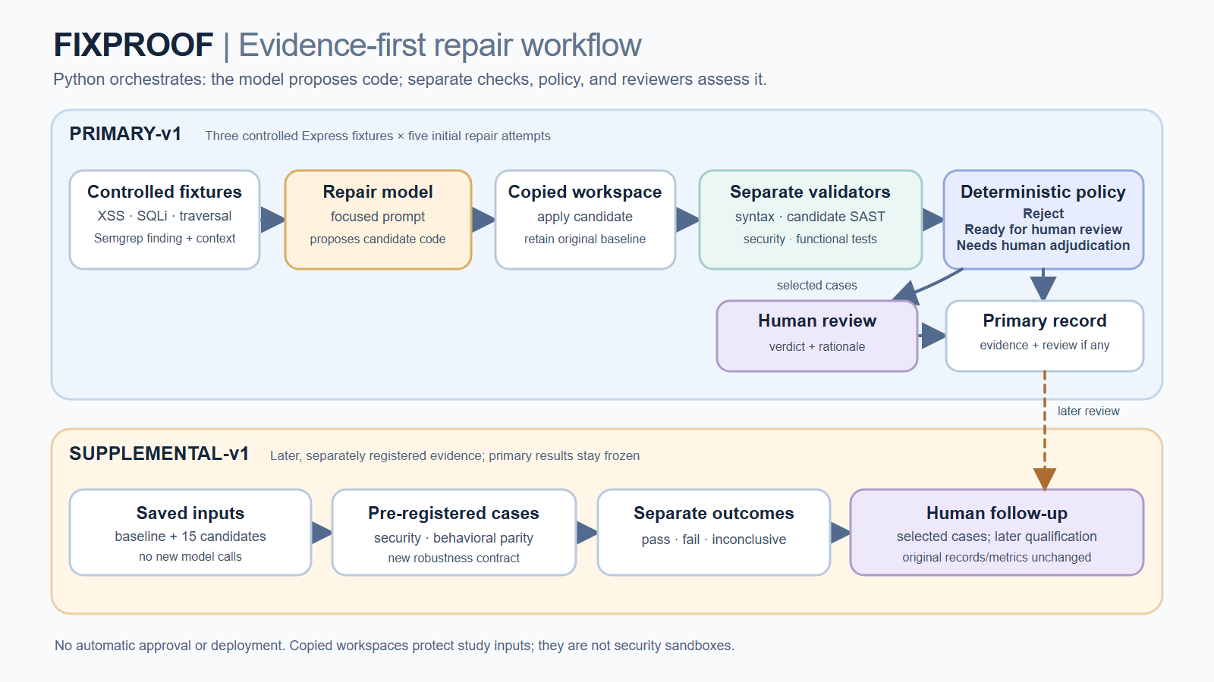
Notes:
Walk left to right through primary-v1: controlled fixtures, focused repair prompt, copied workspace, separate validators, deterministic policy, and human review for selected cases. Then point to supplemental-v1: the later protocol reused saved inputs and candidates, made no new model calls, and stored later qualifications without rewriting the primary record. The cases were predefined and frozen in the project's internal registry before candidate execution; do not imply an external public preregistration. Copied workspaces preserve study inputs; they are not security sandboxes.

Slide 4
2. Frozen primary-v1 study
Five initial calls per CWE; complete all 15; do not stop early based on outcomes
15
5 / 15
15 / 15
10 / 15
scheduled model calls
target SAST resolved
primary security suites
SAST/runtime disagreements
Primary case
Calls
SAST resolved
Security
Functional
Automated state
Reflected XSS
5
0 / 5
5 / 5
5 / 5
Needs adjudication
SQL injection
5
5 / 5
5 / 5
5 / 5
Ready for review
Path traversal
5
0 / 5
5 / 5
5 / 5
Needs adjudication
Total
15
5 / 15
15 / 15
15 / 15
5 ready | 10 adjudicate
0 / 5 resolved means the target scanner finding persisted - not that zero candidates blocked the tested attacks.
CS6727 | FixProof Video III
4
Notes:
The primary protocol scheduled five calls for each fixture and required all 15. Every candidate passed its complete frozen primary security and functional suite. Only the five SQLi targets disappeared from SAST. XSS and traversal retained their findings while runtime checks passed, producing ten SAST/runtime disagreements and human adjudication. The pass columns count candidates, not individual test cases.

Slide 5
3. Supplemental-v1: later, predefined evidence
Same saved candidates | baseline gates first | no new model calls | primary metrics stay frozen
28
3
15
140
registered case definitions
baseline characterizations
saved primary candidates
candidate-case observations
Category
Observations
Pass
Fail
Inconclusive
Interpretation
Security
60
55
0
5
Symlink unavailable
Behavioral parity
45
40
5
0
Observable changes
Robustness
35
25
10
0
New input contracts
Total
140
120
15
5
Mixed categories
Denominators: 12 security x 5 = 60 | 9 parity x 5 = 45 | 7 robustness x 5 = 35
Do not pool these into one "security success rate."
CS6727 | FixProof Video III
5
Notes:
The supplement first characterized each vulnerable baseline, then applied the same relevant cases to the five saved candidates for that CWE. Its 140 observations are case-level outcomes, not 140 patches. Security, parity, and robustness answer different questions, so I report their denominators separately. Five traversal symlink observations remain inconclusive, not passed.

Slide 6
4. Backend demo: follow one evidence chain
Show saved artifacts at high zoom; do not run a new model experiment
1
Frozen plan
trial-plan.json -> 5 per CWE, 15 total, complete all
OPEN BEFORE RECORDING
data/evaluation/
trial-plan.json
ui/primary.html
XSS attempt-03/
candidate.patch
result.json
XSS attempt-04/
candidate.patch
result.json
follow-up result.json
2
Primary result
primary dashboard/report -> persistent SAST + passing runtime
3
Candidate patches
XSS 03 String(value) vs XSS 04 String(value ?? "")
4
Registered result
XSS-P01 -> Hello undefined (pass) vs Hello [blank] (fail)
5
Human record
XSS 04 -> FOLLOW_UP_REJECT_CANDIDATE
Label the dashboard and JSON as saved evidence. Verification checks bindings; it does not replay historical model calls.
CS6727 | FixProof Video III
6
Notes:
Switch from slides to the backend. First show the frozen trial plan fields. Then show the primary dashboard or primary report for XSS 03 and 04. Open the two candidate patches side by side and highlight only String(value) versus String(value ?? ""). Finally, show XSS-P01 in the two saved supplemental result files and the later XSS 04 follow-up verdict. Keep each file on screen only long enough to point to the relevant lines.

Slide 7
5. XSS 03 versus XSS 04
Both passed the registered attacks; one changed missing-input behavior
XSS 03
XSS 04
PATCH
PATCH
String(value)
String(value ?? "")
SAVED XSS-P01 OBSERVATION
SAVED XSS-P01 OBSERVATION
"body": "<h1>Hello undefined</h1>"
"status": "pass"
"body": "<h1>Hello </h1>"
"status": "fail"
Supplement: 9 pass | 0 fail | parity 5/5
Supplement: 8 pass | 1 fail | parity 4/5
Both security: 3/3 pass. XSS 04 follow-up: reject for parity - not because XSS remained exploitable.
CS6727 | FixProof Video III
7
Notes:
This is the central comparison. Both candidates encode HTML and pass all three supplemental XSS security cases. XSS 03 uses String(value), so an omitted name remains the text undefined and passes all five parity cases. XSS 04 uses nullish coalescing to replace a missing name with an empty string, so XSS-P01 fails exact parity. The later rejection is bounded to the frozen parity criterion; it does not mean the registered XSS attacks still worked.

Slide 8
6. Human judgment, limits, and next steps
Later records qualify the evidence; they never overwrite primary-v1
10 original reviews
14 later records
0 overwritten
7 accept | 3 request more testing
5 reject | 5 bounded accept | 4 request
primary records and metrics stay frozen
LIMITS TO SAY OUT LOUD
NEXT COURSE MILESTONES
- One application per CWE
- 15 calls are not 15 unique patches; SQLi has one source
- PATH-S06 remains inconclusive on Windows
- SQLi target comparison used a labeled controlled rule
- No production-readiness or broad success-rate claim
- Planned early Report 3 submission: October 1
- Official Report 3 deadline: October 4, 11:59 p.m.
- Post Video III: October 6
- Peer Feedback Report 3: October 11, 11:59 p.m.
- Continue related work and clean-package rehearsal
Feedback: Would a second reviewer improve confidence more than adding another CWE - or should I prioritize a symlink-capable rerun?
CS6727 | FixProof Video III
8
Notes:
The original ten reviews and the later fourteen records are separate evidence layers. The later decisions include five rejections, five bounded SQLi acceptances, and four traversal requests for more testing. End by stating the limits explicitly and asking one focused design question. Mention that Progress Report 3 is due October 4, Video III posts October 6, and peer feedback is due October 11. Close with the course AI-use disclosure: Codex and ChatGPT assisted implementation, analysis, and presentation preparation; separate saved OpenAI API calls proposed experimental repairs; I made the recorded human decisions and remain responsible for the claims.

Slide 9
BACKUP | If asked about SQLi or traversal
Skip during the main recording unless the course format allows extra detail
SQLi 01-05
Traversal 02-05
Primary target SAST: 5/5 resolved
Primary security + functional: 5/5 candidates pass
Supplement per candidate:
- Security 3/3
- Parity 2/2
- Robustness 2/3
SQL-R01: repeated usernames returned HTTP 200 [] instead of registered HTTP 400.
Human result: bounded accept; failure remains recorded.
Primary target SAST: 0/5 resolved
Primary security + functional: 5/5 candidates pass
Supplement:
- Five executable security cases pass per candidate
- PATH-S06 symlink case remains inconclusive
- Traversal 03 fails R01-R03
- Traversal 05 fails R03
Human result: request more testing; no symlink-safety claim.
Full matrices and rationales: Video-III-15-candidate-evidence-appendix.pdf
BACKUP | CS6727 | FixProof Video III
9
Notes:
Backup only. Use this slide if someone asks why SQLi was accepted despite SQL-R01 or why traversal requests more testing. Keep security, parity, and robustness interpretations separate. SQL-R01 is a low-impact robustness failure under Tony's bounded criterion. PATH-S06 is inconclusive and prevents a complete symlink-safety claim.

